Slide 1

Introduction to Docker U.S Patent & Trade Office 3/28/2017

Slide 2
About DI
Founded in 2003; headquartered in Boulder, Colorado
Founder and CEO, Kelby Zorgdrager, has 20 years’ experience in Technical Learning and Development
More than 40,000 developers trained in 30 countries since 2003
Managed and delivered learning solutions to more than 4,000 developers globally in 2014
Over 200 different course offerings available in Open Source, Java development, web and mobile application development, cloud computing, and more

Slide 3





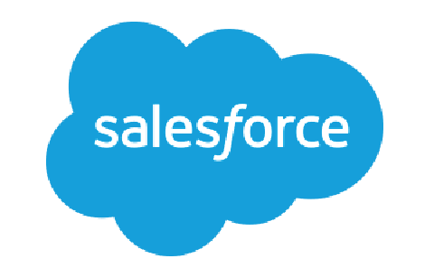










Our Customers Include

Slide 4
About the Instructor
Background: Six years military (two tours in Iraq) defusing mines followed by four years at Amazon.com in operations. Transitioned to the gaming world in 2009 as a coder.
Been coding for ~ 10 years:
LAMP stack initially
Transitioned to Python, MongoDB, ELK
Introductions!

Slide 5
About the Docker Course
In this course we will be covering docker and how it is used in modern development/ops for large scale application environments.
We will primarily focus on the practical side of docker through six lab sessions along with some lecture portions.
At the end of the course we will have built out a containerized application using docker concepts and configurations.

Slide 6
About the Docker Course
Most of our labs will come from the perspective of the developer- though we will also talk (on day three) about the role that ops will play in deployment of docker containers and the most efficient way to handle this.
I have created Vagrant machines for us to use when creating docker containers. This should make our system OS agnostic.

Slide 7
Housekeeping
Class schedule:
Pretty simple: Around 2.5 hours then 20 minute break broken into three parts:
Meet n’ greet: 8:30 – 9am
Module 1: 9-11am
Module 2: 11am- 1pm
Lunch: 1pm- 1:30pm
Module 3: 1:30pm = 3:30pm
Module 4: 3:30pm – 5pm
Questions & whatnot: after 5pm
Breaks:
As needed. Nothing formal (we’re all adults!) but one rule: PLEASE do not return to your workstations and start “doing email” or I will NEVER SEE YOU AGAIN!

Slide 8
Docker Containerization

Slide 9
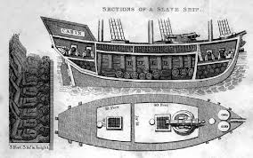
Introduction to Containerization
Think back to the 15th and 16th century before we start. You are a cargo master and you want to move 15 tons of cargo across the Atlantic Ocean from New York to London.

Slide 10
Introduction to Containerization
Now imagine that you have to load different types of cargo as part of this 15 tons. Some of it is coffee, some of it is whale oil, some is sugar, vinegar, wheat, flints, etc.
All of it is stored differently- some things in bags, some in crates, some in barrels.
You need to stuff these bits in different places but you also have to be careful…you can’t put the flints next to the oil (for example), or the vinegar next to the sugar or it will be ruined.

Slide 11
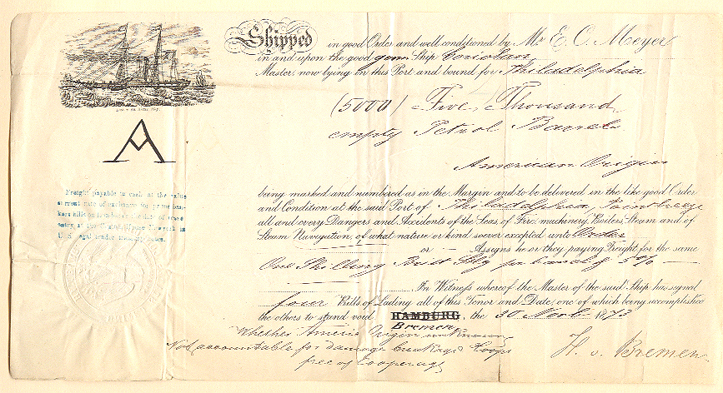
Introduction to Containerization
What companies used to do is hire cargo masters for this complex operation. The cargo masters would have to optimize space in the hold whilst simultaneously ensuring that nothing was too close to something that would ruin it during the journey.
This was a complex and difficult job that would require highly skilled labor to complete effectively.

Slide 12
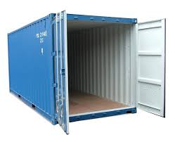
Introduction to Containerization
If the cargo master screwed up then the whole trans-atlantic voyage was an exercise in utter futility. The items were useless by the time they reached their destination and everything was ruined.
So cargo masters were extremely well paid for their labor (obviously).
In 1953 a gentleman named Malcolm Mclean invented the modern shipping container.

Slide 13
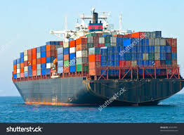
Introduction to Containerization
McLean realized a simple, basic truth- that if we standardize the way we ship things we will be able to ship more of them.
With the shipping container we no longer have to put several different types of containers onto a ship- we put them into a standard container which then goes on to the ship
Now we have containerization.

Slide 14
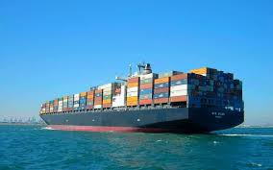
Introduction to Containerization
Thanks to McLean our ability to ship items has gone up an estimated 44% per shipment- allowing shipping companies to ship more in these standard containers than they used to in holds (because they could be stacked).

Slide 15
Introduction to Containerization
If you haven’t figured out yet- the shipping containerization idea is our analogy to what docker actually is in practice.
Docker seeks to create a standard “shipping container” for apps going to production.
Our cargo master is the sys-ops guy who is responsible for making sure that all of the packages “fit together” in the “hold” (our application production environment).

Slide 16

Introduction to Containerization
Obviously his or her job is incredibly complex while doing this (“will package abc cause package def to fail in this environment? Do we have versioning under control? I have multiple devs- what if their code collides? What if I have missing dependencies?”)
Just as with our cargo master our sys-ops person must work diligently to make sure that our code “survives the journey” when we “ship it”

Slide 17
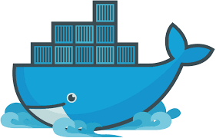
Introduction to Containerization
Docker seeks to solve this problem by creating “containers” that act as “microservices” for each part of an application.

Slide 18
Current state of application development
Currently application development works something like this in modern contexts:
The developer requests a development environment from the ops team in order to begin working on a new product or feature.
The ops team spins up a VM (usually with Vagrant or something similar) with all of the packages necessary to make a copy of staging/production
The ops team passes on the VM to the developer in the form of a VagrantFile (or maybe including the image).
The developer spins up the Vagrant machine and now has a production environment on their desktop

Slide 19
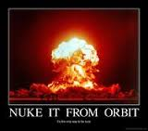
Introduction to Docker
The downside to this tactic is that it is often slow and cumbersome for the developer to set up a new VM. Go ahead and time a Vagrant up or download an ubuntu or Centos or Windows image from the web.
Also- all of the dependencies are locked into a single machine. If we nuke the machine for some reason- bye bye apache server, code, front end.

Slide 20
Introduction to Docker
With Docker we kind of run microservices applications in individual (shipping) containers that allow us to:
a: separate the work into unique containers
b: keep our dependencies separate and
c: (my favorite as a developer) download containers directly from some company registry (so that we don’t end up waiting on sys-ops to make us a VM that matches production.
This saves tons of development time not waiting on VM environments.

Slide 21
Introduction to Docker
The Old Way to deploy applications was to install the applications on a host using the operating system package manager. This had the disadvantage of entangling the applications’ executables, configuration, libraries, and lifecycles with each other and with the host OS. One could build immutable virtual-machine images in order to achieve predictable rollouts and rollbacks, but VMs are heavyweight and non-portable.

Slide 22
Introduction to Docker
The New Way is to deploy containers based on operating-system-level virtualization rather than hardware virtualization. These containers are isolated from each other and from the host: they have their own filesystems, they can’t see each others’ processes, and their computational resource usage can be bounded. They are easier to build than VMs, and because they are decoupled from the underlying infrastructure and from the host filesystem, they are portable across clouds and OS distributions.

Slide 23

Introduction to Docker
Here is the process the developer now follows:
Decide which aspect of the program you are working on (maybe the “Model” in an MVC framework- so the database).
Go up to the company registry and download the, let’s say, mysql docker container
Make alterations to the database inside that container.
Send it through the pipeline (QA, Integration, Staging, Production)

Slide 24

Introduction to Docker
From the perspective of the OPS guy/gal:
Instead of building VMs all the time you just have to update the VMs that exist in the registry.
You have separation of all sorts of aspects of code into separate containers (so maybe a postgres container, maybe a ruby container, etc…)
You spend less time worrying about dependencies and cross dependencies and making sure that VMs work and more time doing whatever Sys-ops guys do when not building me VMs.

Slide 25
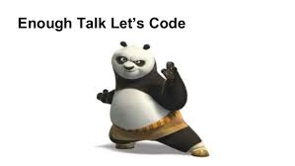
Introduction to Docker- LAB #1

Slide 26
LXC, Containers, under the hood

Slide 27

Introduction to LXC
The main idea behind docker (as a shipping container) is this: it doesn’t care what kind of ship it’s on.
This means that it is completely agnostic regarding whether the underlying operating system is Windows, Ubuntu, Centos, OSx- it will basically treat everything the same.
This is how it remains lightweight and flexible.

Slide 28
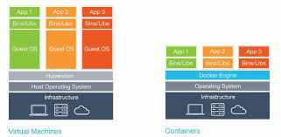
Containers vs. Virtualization

Slide 29
So how does it do this?
Docker is able to accomplish all of this because unlike virtual machines it isolates and encapsulates application workloads from your Operating system.
With virtual machines there is a hyperviser
There is no hypervisor that has to communicate with the underlying operating system as there is with virtual machines.
The Hypervisor is basically what is managing resources for the VM from the underlying physical machine.

Slide 30
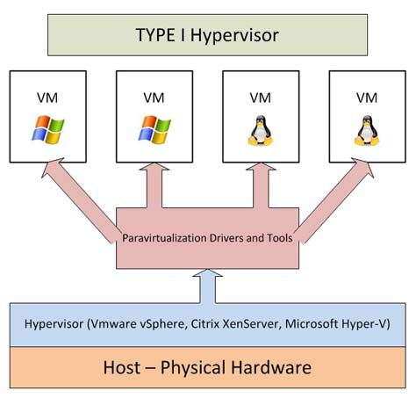
So how does it do this?

Slide 31
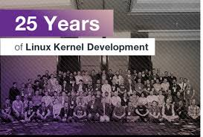
LXC
Docker is relatively self contained- it does not care about underlying storage or file systems. It does not “virtualize” or emulate the underlying storage system- it simply uses a linux kernel, takes it’s resources, and runs.
It is similar- but not the same as a project called LXC (Linux Containers)
Highlighting LXC vs Docker might provide some insights.

Slide 32
LXC
LXC stands for Linux Containers (I know, I know…)
It utilizes a single Linux Kernel and is able to divide up resource management using cgroups and namespaces in the Linux Kernel
This means that I can have an Ubuntu machine and partition off resources in the kernel to run a CENTOS image and another partition for an OSx image and so on…
There are six namespaces in Linux (mnt, IPC, net, usr etc.). Using these namespaces a container can have its own network interfaces, IP address etc. Each container will have its own namespace and the processes running inside that namespace will not have any privileges outside its namespace.

Slide 33
LXC vs Docker
Think of Docker as an LXC wrapper. There are some key differences that it is essential to highlight in this environment, including:
Linux cgroups can run full stack development as virtualization layers
Basically- each LXC container is it’s own VM with an OS behind it
DOCKER is intended as a single application small container
The Docker containers are not intended to provide persistent data (that is done through data mounts to the host system– more on this later) whereas LXC can.
LXC usually has a fully functional OS behind it and can perform as well (nearly) as bare metal. Docker is really not designed to use the entire OS (if you find yourself putting too many features for the OS into a container- you are probably doing it wrong).

Slide 34
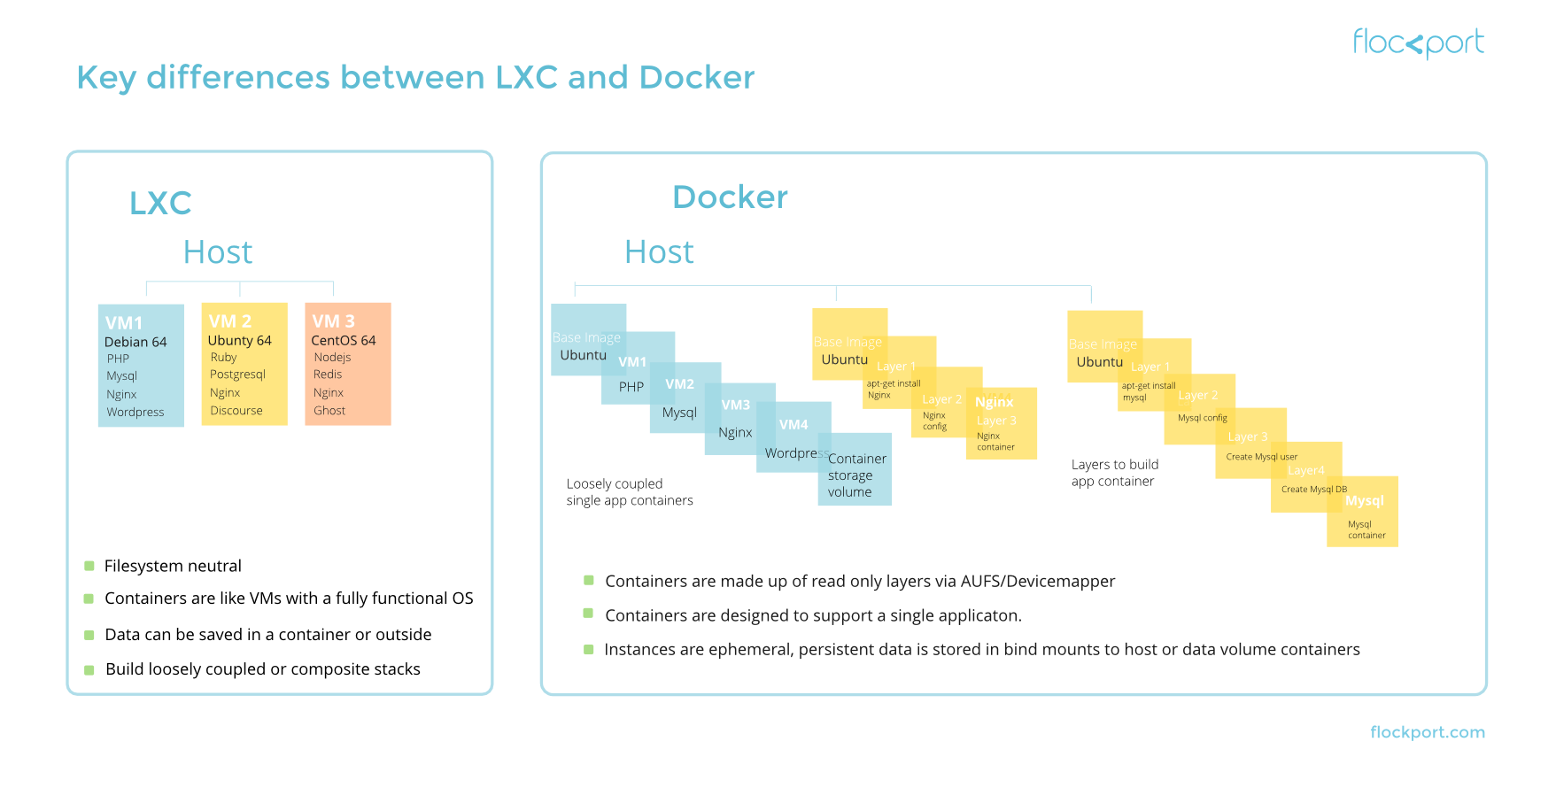
LXC

Slide 35
Docker Images

Slide 36
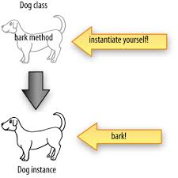
Docker Images
So now that we’ve brought down a couple of images let’s discuss what we’re doing here.
Docker containers are built from light weight images- which are basically classes from which our containers are built
In the development world- think of the image as the class and the container as the instantiation of that class.

Slide 37
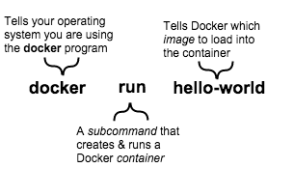
Docker Images
When we create these images we are basically mapping out our container using data in the image to do so.
Once the command to run an image is invoked a few things happen:

Slide 38

Docker Images
Docker will run a quick check to see if you have the image stored locally in your filesystem
Assuming that Docker fails to find the image locally it will reach out to a registry or hub in order to download a copy of the image locally.
Once the image is received the container is built based on instructions embedded in the image.

Slide 39
Docker Images
When you use the Docker run command to “run” an image you are asking the image to perform a task.
If you are using Docker in line with the ideas of containerization this is probably a relatively simple task- maybe:
“Listen on port 80”
“Display ‘Hello World’ to stdout
Port forward to 8080 and display this index.html file
There are both images that do one thing and die and daemonized images that, while running, will wait (for instance- our webserver example).

Slide 40
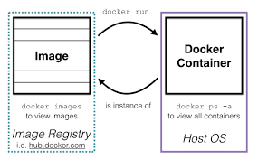
Docker Images
Once you are “running” an image it actually changes state to a container. To see a list of running images on your system you will type in docker images.
You can remove any running image by typing docker rmi <image id> to delete it.
Remember that images are basically just maps- they are distinct from containers.

Slide 41
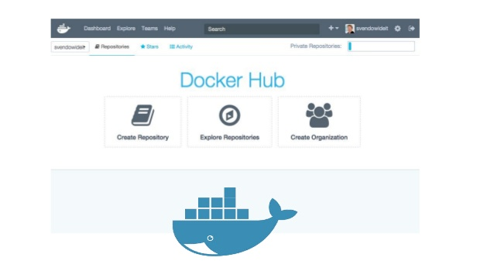
Docker Image registries
So where do we go to get images?
There are a ton of hubs and registries to access various images out there and, because they are so lightweight, it’s pretty easy to download as many as you want! (try doing that with VMs!)
The main Docker hub out there is:
https://hub.docker.com/
Sign up is free and you can go there to:
Create a registry
Download various images
Upload and manage your own images

Slide 42
Docker Image registries
Everyone take 15 minutes to explore the Docker Hub.
This is a worthwhile exercise when getting started with this technology- it will allow you to recognize some of the freely available images provided by Docker
Please download the following images:
#TODO
#TODO
#TODO

Slide 43
Managing Docker Images
Docker image registries are one of the more powerful aspects of Docker from a Dev/Ops perspective.
Essentially you can make a single image for each of the aspects that your devs might need, give them access to a docker registry, and have your devs basically build their own environments.
So from a dev perspective you might have an image of a CentOS machine that your devs pull to work on.
So the next (and obvious question) is: how do I make this match the production environment?

Slide 44
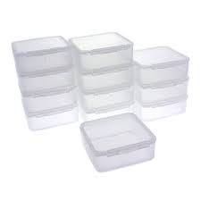
Be careful though!
Again- please note the concept of containerization here, however!!
You should have numerous docker images in your registry- each one designed to address some specific aspect of the production environment
So unlike with virtual machines and the like- your docker images need to be very specific to small sub-tasks of your overall eco-system.

Slide 45

The big idea…
The big idea here is that your devs, as they are developing, can pull docker images directly from the registry and do their development work.
It means that sys/ops folks no longer need to create virtual machines for each dev every time they need something- which leads to greater productivity

Slide 46
So how do we customize these images?
And now we get into the interesting portion of the talk- customizing images (making our own, basically)

Slide 47
Docker Containers and the DockerFile

Slide 48
Docker Containers
Let’s start by going through the most important command line commands in docker one at a time.
This is essential for understanding and managing containers and filesystems within the containers.

Slide 49
Docker Pull
docker pull:
All of our git users should be intimately familiar with this one- docker pull pulls an image from a docker repo locally. This command is kicked off automatically if you docker run an image and the image is not found (the image will be searched for and if not found will pull from the docker repo.
docker run:
This is how we run containers (obviously). We actually run an image and a container is created. We will dive deep into this in the images section.

Slide 50

Dockerfile
The Dockerfile is the base map from which our images are built.
It is a simple, straight forward, and easy-to-read list of all of the libraries, OS’, and environment variables we want built into our image when it becomes a container.
Please download the DockerFile available in the git repo and let’s talk through each aspect

Slide 51
Dockerfile
# = Comments
FROM: What image do you want to use?
Recommend base images from official repos and try to use Debian images
If you use the “:latest” image you will get the most recent image version. You can look at earlier images if you’d like but you have to specify that. Latest will look for the most recent (and recommended) LTS.
The format is any of these:
FROM <image>
FROM <image>:<tag>
FROM <image>@<digest>*
*a digest is an SHA256 hash of the image’s json configuration object.

Slide 52

Dockerfile
# = Comments
MAINTAINER: Who are you?
This is simply good practice- introduce yourself and take credit for your work!

Slide 53
Dockerfile
LABEL: Metadata about your container
This is a “key=>value” store where the value needs to be a string.
This metadata will allow you to organize your images by project, swarm, cluster, etc.
You can see the labels for a given container by running the docker inspect command.
"Labels": {
"com.example.vendor": "ACME Incorporated"
"com.example.label-with-value": "foo",
"version": "1.0",
"description": "This text illustrates that label-values can span multiple lines.",
"multi.label1": "value1",
"multi.label2": "value2",
"other": "value3"
}

Slide 54

Dockerfile
ENV: Set your environment variables!
Pretty straightforward- set an environment variable by stating ENV var=var
You can also pass in your local environment variables, i.e: ENV var = ${var}
This will result in your local Environment variable
This helps when you start developing within the Docker container that you just built

Slide 55

Dockerfile
VOLUME: This is how you set a mount with any specified name and mark it. This is essential because (and this is kind of key)- data does not persist in Docker containers.
The whole idea of a container is that the container itself can be torn down and put back up 100 times. If you want persistent data it must be in a mounted file on the host machine.
I speak from experience on this- if your container transforms a thing- make sure the output goes to a mounted file and the code is stored in a mounted file.

Slide 56
Dockerfile
ARG: This one is for any arguments your users might want to pass in the command line using the –build-arg flag.
The obvious temptation here is to use the ARG command to pass in github keys or s3 secret keys as such: ARG secret
…and then on the command line:
docker build –build-arg secret=rewjirew90 -<Dockerfile
Please note that this is not recommended by Docker as outside sources can run “docker history” and pull out your secret.
Docker is still working on this issue

Slide 57
Dockerfile
ARG: This one is for any arguments your users might want to pass in the command line using the –build-arg flag.
The obvious temptation here is to use the ARG command to pass in github keys or s3 secret keys as such: ARG secret
…and then on the command line:
docker build –build-arg secret=rewjirew90 -<Dockerfile
Please note that this is not recommended by Docker as outside sources can run “docker history” and pull out your secret.
Docker is still working on this issue

Slide 58
Dockerfile
ARG (con’t): There is a list of predefined variables that you can pass at build time:
* HTTP_PROXY
* http_proxy
* HTTPS_PROXY
* https_proxy
* FTP_PROXY
* ftp_proxy
* NO_PROXY
* no_proxy

Slide 59

Dockerfile
EXPOSE: This is one of the best parts of Docker- port forwarding made easy!! Just do:
EXPOSE 80
And Docker is listening on port 80!
When we get to linking containers with the Docker YAML file this is how we will link them.

Slide 60
Dockerfile
EXPOSE: This is one of the best parts of Docker- port forwarding made easy!! Just do:
EXPOSE 80
And Docker is listening on port 80!
When we get to linking containers with the Docker YAML file this is how we will link them.

Slide 61
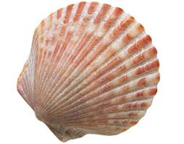
Dockerfile
SHELL: This instruction allows the default shell used for the shell commands to be overridden. SO- for example- the default shell on LINUX is [“/bin/sh”, “-c”].
This is the one I plan to use in this class- though if you would prefer Windows that can be used with ["cmd", "/S", "/C"]
Basically this works as:
[“executable”, “parameter”, “parameter”…]

Slide 62
Dockerfile
ADD: This is how we add files to our Docker container to run them. If you are storing, say, a python file locally you can add this to your Dockerfile and it will be added in to your Docker container on build. It’s built as ADD <src> <dest> where <src> can be a URL, a local directory (in which case all files in the directory are copied) or a tar file (in which case it is unpacked as a directory).
It will have a default permissions value of 600 on build.
If <dest> ends with a trailing “/” then <src> is copied in there.
Wildcards *are* allowed here.
ADD src/file.py /usr/include/mylib/file.py

Slide 63
Dockerfile
ADD: This is how we add files to our Docker container to run them. If you are storing, say, a python file locally you can add this to your Dockerfile and it will be added in to your Docker container on build. It’s built as ADD <src> <dest> where <src> can be a URL, a local directory (in which case all files in the directory are copied) or a tar file (in which case it is unpacked as a directory).
It will have a default permissions value of 600 on build.
If <dest> ends with a trailing “/” then <src> is copied in there.
Wildcards *are* allowed here.
ADD src/file.py /usr/include/mylib/file.py

Slide 64
Dockerfile
ONBUILD [INSTRUCTION]: This is how you would add a trigger instruction to be executed at a later time if this image is used as the base for another build.
The trigger will be executed in the context of the downstream build, as if it had been inserted immediately after the FROM instruction in the downstream Dockerfile.
This is primarily if you intend for your container to become the base image for future containers- you might do:
ONBUILD RUN /usr/sbin/hereisathing.sh

Slide 65
Dockerfile
ONBUILD [INSTRUCTION]: This is how you would add a trigger instruction to be executed at a later time if this image is used as the base for another build.
The trigger will be executed in the context of the downstream build, as if it had been inserted immediately after the FROM instruction in the downstream Dockerfile.
This is primarily if you intend for your container to become the base image for future containers- you might do:
ONBUILD RUN /usr/sbin/hereisathing.sh

Slide 66

Dockerfile
COPY: Basically ADD without the tar auto-extraction capability.
Generally I utilize ADD- but COPY does a lot of the same things
It copies files from <src> to <dest> where the files can either be absolute paths or paths relative to the WORKDIR (more on that later)

Slide 67
Dockerfile
RUN: This is usually the most used and most filled section of the DockerFile.
This is where you list your shell commands that run on build.
Most of the time you are going to be setting up all of the libraries and packages you want with the image you are going to build using this command. So basically your command would look like this:
RUN yum update -y && yum install fuse fuse-devel wget sudo pylint git mariadb-devel which tar nc unzip curl libffi-devel postgresql-devel netcat python-devel python-pip -y \
&& yum install -y krb5-devel curl-devel cyrus-sasl-devel openssl-devel make gcc gcc-c++ patch cmake libxslt-devel glib2-devel libxml2-devel blas-devel lapack-devel -y \

Slide 68
Dockerfile
As a developer the way we manage our Dockerfile is that I pull the most recent version before I develop and then if I want, say, a python library or something then I will edit the Dockerfile with a pip install foobar
From here I would do a pull request which, assuming my sys team approved it, that library would be added to the Dockerfile and we would be off to the races.
RUN can be used with different shells as well (i.e:
RUN [“sh”, “-c”, “echo $HOME”]

Slide 69
Dockerfile
WORKDIR: This is the working directory for an RUN, CMD, COPY, ADD, ENTRYPOINT (basically anything you put in there will run relative to your last WORKDIR entry).
WORKDIR can be cited numerous times in a DOCKERFILE and each one will be relative to the last one unless you start with an absolute path
WORKDIR /path/to/workdir

Slide 70
Dockerfile
USER: The USER instruction sets the username or UID to use when running the image and for any RUN, CMD and ENTRYPOINT instructions that follow.
Obviously you will mostly want the user to have superuser permissions
USER yournamehere

Slide 71
Dockerfile
ENTRYPOINT: The ENTRYPOINT instruction is similar to the CMD instruction. It’s basically the shell command you want your container to run on build.
Runs on docker run from /bin/sh or /bin/bash
**Your docker container must have an ENTRYPOINT or CMD instruction in the docker file in order to respond to docker run**
There are two form here:
Shell form: basically think of the command as coming after /bin/sh –c, so for example:
ENTRYPOINT ping localhost
Executable form: run without a shell as an executable and in json format for a list:
ENTRYPOINT [“/bin/ping”, “localhost”]

Slide 72
Dockerfile
ENTRYPOINT: The ENTRYPOINT instruction is similar to the CMD instruction. It’s basically the shell command you want your container to run on build.
Runs on docker run from /bin/sh or /bin/bash
**Your docker container must have an ENTRYPOINT or CMD instruction in the docker file in order to respond to docker run**
There are two form here:
Shell form: basically think of the command as coming after /bin/sh –c, so for example:
ENTRYPOINT ping localhost
Executable form: run without a shell as an executable and in json format for a list:
ENTRYPOINT [“/bin/ping”, “localhost”]
Personal preference: always use exec- it will always be PID 1 in the container

Slide 73
Dockerfile
ENTRYPOINT: The ENTRYPOINT instruction is similar to the CMD instruction. It’s basically the shell command you want your container to run on build.
Runs on docker run from /bin/sh or /bin/bash
**Your docker container must have an ENTRYPOINT or CMD instruction in the docker file in order to respond to docker run**
There are two form here:
Shell form: basically think of the command as coming after /bin/sh –c, so for example:
ENTRYPOINT ping localhost
Executable form: run without a shell as an executable and in json format for a list:
ENTRYPOINT [“/bin/ping”, “localhost”]
Personal preference: always use exec- it will always be PID 1 in the container

Slide 74
Dockerfile
CMD: Similar to ENTRYPOINT with a few key distinctions:
CMD can have parameters overridden from the command line very easily with docker run. This makes it flexible for where you might want to give the user options for the container. Here’s an example:
CMD ping localhost
docker run –t demo #to tag the image as demo
64 bytes from localhost (127.0.0.1): icmp_seq=1 ttl=64 time=0.051 ms
64 bytes from localhost (127.0.0.1): icmp_seq=2 ttl=64 time=0.038 ms
docker demo hostname
6c1573c0d4c0
hostname was run in place of demo

Slide 75
Dockerfile
By way of example you can also override an ENTRYPOINT command however it must be specified:
docker run –entrypoint hostname demo
When you want to make it easier for your user to add parameters to your container- use CMD.
When you want your container to act as a standalone- use ENTRYPOINT.
You can combine the two and CMD will be appended to the end of ENTRYPOINT commands but if you do this they must both use exec forms:
ENTRYPOINT ["/bin/ping","-c","3"]
CMD ["localhost"]
/bin/ping -c 3 localhost

Slide 76
Dockerfile
HEALTHCHECK: just as expected- this is a check run to see if the docker container is healthy by running a test at startup. Docker containers in this case two states for an exit code status:
0: success- healthy container
1: unhealthy- the container is not working correctly
The health is checked by utilizing a CMD to run inside the container. So an example might be:
HEALTHCHECK --interval=15 --timeout=60 --retries=5 CMD [ "/usr/bin/my_health_check_script", "arg_1" ]

Slide 77
Dockerfile
When we run the docker build command what’s happening is:
Docker will scan the root file directory for a Dockerfile from which to build context
Docker will build the image based on information found in the Dockerfile
You have several options with the Dockerfiles. The most common are:
-t or tag (tag your image with a human-readable easy name)
-f or –file (path to your docker file)
--pull (always attempt to pull a newer version of the image)
--no-cache (rebuild the image from scratch without using cache- useful if you change significant commands in the Dockerfile)
--force (remove intermediate containers)
Less common but still useful:
--quiet (supress the build output and print image ID on success)
--security-opt (security options)
--squash (squash newly built layers into a single new layer)
--memory (set upper limits for memory usage)

Slide 78
Dockerfile

Slide 79
Docker Networks

Slide 80
Docker Networking
So the question we left with is: How do we “connect” multiple containers?
The answer is: through docker networking
The first step is, of course, to create a network:
sudo docker network create app
What happens behind the scenes here is a bridge network called “app” is created and a network id is returned
We can then inspect the network with:
sudo docker network inspect app
And we learn that our new network is a local, bridged network with no containers currently running inside it

Slide 81
Docker Networking
The command
docker network ls
Will list all available networks (docker rm will remove them)
Let’s add some containers!
sudo docker run –d –net=app –name db jamtur01/redis
Now rerun our docker inspect
So notice the –net usage here. This is how we add containers to a single network. Any docker run that we run with –net will be added to that network

Slide 82
Docker Networking
So what is this good for?
Basically we can manually build these containers to connect and run microservices and make more and more complex services out of them.
This will allow us to keep our smaller apps “containerized” and therefore any issues with containers, well- we can rebuild that one container (instead of the whole app).

Slide 83
YAML files and DOCKER COMPOSE

Slide 84
Docker-Compose
So we’ve been talking about docker primarily as a micro-services application with each container making up one section of the service (container 1 = apache web server, container 2 = code, etc)
The question now becomes- how do we “wire” these micro-services together in order to make a single, effective application? (read: put them in the same network)
The docker yaml file was created for this (partnered with docker-compose)

Slide 85
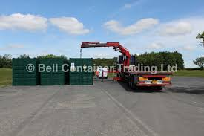
Docker-Compose
The docker-compose command will create a local network (based on the folder in which it is created) and then spin up multiple containers based on inputs into yaml file entries in the docker-compose.yml
From within this “network” all of the containers can be linked together and form dependencies but, and this is key, still be independent containers.

Slide 86
Docker-Compose
The docker-compose yaml is broken down into three sections:
services: A service definition contains configuration which will be applied to each container started for that service, much like passing command-line parameters to docker run.
networks: These are the variables passed to setting up your network (set IPV6 to true/false, etc).
volumes: When used as a high level variable you can specify things like drivers to be used when creating volumes and mounts.

Slide 87
Docker-Compose
Let’s go through some of the most common entries in the docker-compose.yml services section:
build: this is where we specify the path to the build context (or alternately a git url)
We can establish Dockerfile locations here as an option and specify specific args as well:
build: ./dir
image: whatevs:tag
build:
context: ./dir
dockerfile: Dockerfile-alternate
args:
buildno: 1
pass: <password>

Slide 88
Docker-Compose
Now- in the build you saw that we passed two args- which we can specify in the yaml and will then be passed to the Dockerfile.
So as you say- we passed buildno and password, so now in the Dockerfile we can pass:
ARG buildno
ARG password
RUN echo "Build number: $buildno"
RUN script-requiring-password.sh "$password"

Slide 89
Docker-Compose
depends_on is important because it specifies the order in which your containers should be built, so if you have a container that requires a separate container to be built- you want to include this under your services section.
Example:
services:
web:
build: .
depends_on:
db:
condition: service_healthy
redis:
condition: service_started
redis:
image: redis
db:
image: redis
healthcheck:
test: "exit 0"

Slide 90
Docker-Compose
environment: Just like with our Dockerfile- we can add environment variables here.
environment:
RACK_ENV: development
SHOW: 'true'
SESSION_SECRET:
expose: Expose ports through port forwarding with “8888:8888” or whatever port number
links: This is how we link to the other containers in separate services

Slide 91
Docker-Compose
logging: Set up the logging configuration for this particular service. You can set up the logging driver (json-file by default but you can certainly use journald as we did earlier)
container_name: Set up alias for your container

Slide 92
DOCKER SWARM

Slide 93
Docker Swarm
So the obvious next question here is: how do we manage all of these containers & services that we’ve been putting together?
The market has several options out there to do this- including products like:
Google’s Kubernetes
Apache Mesos
Flocker
Helios
Weave

Slide 94
Docker Swarm
So imagine that you had to run hundreds of these containers across a distributed mode. You will need several tools to monitor this including tools that provide:
Health checks on containers
Launching of a certain number of containers for a particular Docker image
Scaling the number of containers up and down depending on the load
Updating software
Controlling nodes and interfaces

Slide 95
Docker Swarm
Recently (as of Docker 1.12) Docker has attacked this problem with an application known as Docker Swarm.
A swarm is a series of Docker engines participating in a cluster. You have two options in swarm mode:
Initialize a swarm
Join a swarm

Slide 96
Docker Swarm
Now some of the terminology will get confusing!
Usually when we speak of nodes in a cluster we are referring to a computer in a cluster of other computers.
In the docker engine a node is an instance of the Docker engine participating in the swarm.
So let’s address the “docker hierarchy” as it were. You will recall that a docker-machine is a tool that allows you to install Docker Engine on certain hosts (local Mac, Windows, Linux).
When we say Docker Engine we generally are referring to the Docker daemon, REST API, and CLI client that talks to the daemon.

Slide 97
Docker Swarm
Docker Machine is a tool for provisioning and managing your hosts that have Docker engines on them. Docker Machine has it’s own command line client.
Basically- you use Docker Machine to install Docker Engine on your choice of hosts.

Slide 98
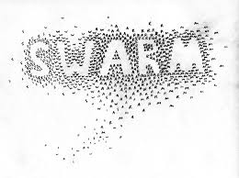
Docker Swarm
Going one level of abstraction up from here- you will want Docker engines deployed on multiple hosts and to manage those hosts with Docker Swarm.

Slide 99
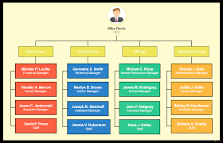
Docker Swarm
First think of the swarm as (of course) a cluster.
The swarm cluster will have a manager node and worker nodes within the cluster. You submit a service definition to a manager node which then dispatches units of work to worker nodes.

Slide 100

Docker Swarm
The manager will do this in units of work known as tasks which it will hand out to workers.
The task is the atomic scheduling unit of swarm.
Think of it as a Docker container and the commands to run inside of that container.
The manager node will assign tasks to worker nodes according to the number of replicas set in the service scale.

Slide 101
Docker Swarm
BUT- you need to define these tasks- and that is at the service level.
In swarm a service is the definition of the tasks to execute on the worker nodes.
The service will do things like specify the container image to use and which commands to execute inside of the container

Slide 102
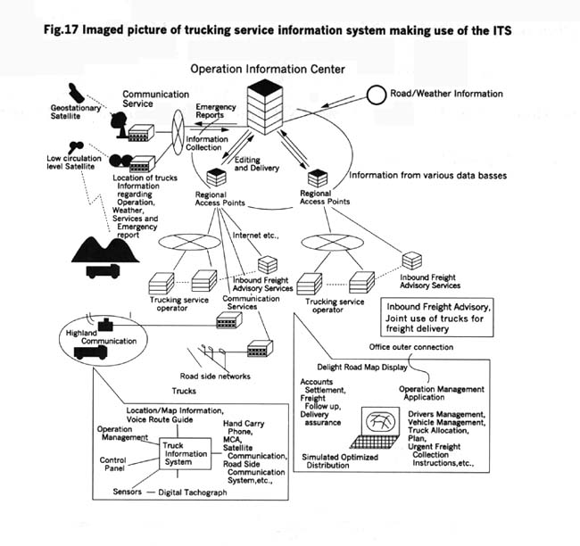
Docker Swarm
Think of it as analogous to a trucking distribution system:
You have the truck dispatch (manager node)
The Drivers (worker nodes)
Who drive tasks (the trucks)
With containers full of stuff (the service- which is what is going into the containers)

Slide 103
Docker Swarm
So why SWARM? (from the documentation)
Cluster management is integrated with the docker-engine
Scaling (for each service you can declare the number of tasks you want to run so you can scale up or down)
The swarm manager node will monitor the cluster state and reconcile any differences between what you want and where you are.
Load balancing
Rolling updates

Slide 104
Dockerfile

Slide 105
Kubernetes, Mesos and other management options

Slide 106

Other management tools
This section will be a quick review of other management tools available for Docker containers, including kubernetes, mesos, Dockersh.
We will touch on each of these but there will not be labs or demos around them.

Slide 107
Other management tools
Kubernetes:
Originally developed by Google to manage their LXC containers
At a minimum kubernetes schedules and runs application containers on clusters of physical or virtual machines- however one of the big advantages is that kubernetes is fairly host agnostic- a developer can “cut the cord” from the host and make a container-centric infrastructure.
Kubernetes aids you in co-locating helper processes, mounting storage systems, distributing secrets, checking on application health, auto scaling, rolling updates, load balancing, and so much more.

Slide 108
Other management tools
Apache mesos:
Somewhat similar to Docker swarm it utilizes a scheduler that works with a master (think manager node) and deploys mesos agents (think worker nodes).
It is similar to the YARN architecture that has been popularized in Hadoop- with workers querying for resources, master sending resource offers, and then the master sending tasks to the worker nodes
Also free and open source.

Slide 109
Other management tools
Codefresh:
Builds Docker images on every change in a branch or pull request- which can turn your deployment structure into (practically) something automatic.
Allows for continuous integration by running unit tests, integration tests on deployed docker containers
Accessible to any cloud (allows auto-deployment at the end of every build process).

Slide 110
Other management tools
Prometheus:
Open source framework originally created by Soundcloud that provides monitoring and analytics for Docker containers
Flocker:
An open-source container data volume orchestrator. It can be used in any container and allows you to run your entire database inside Docker containers and leverage persistent storage. It integrates with Kubernetes and Mesos.
Helios:
Developed by Spotify and used in production there this is an open source platform that handles multiple http request simultaneously to allow you to run hundreds of machines at once.

Slide 111
Review and Q & A

